Slide 1

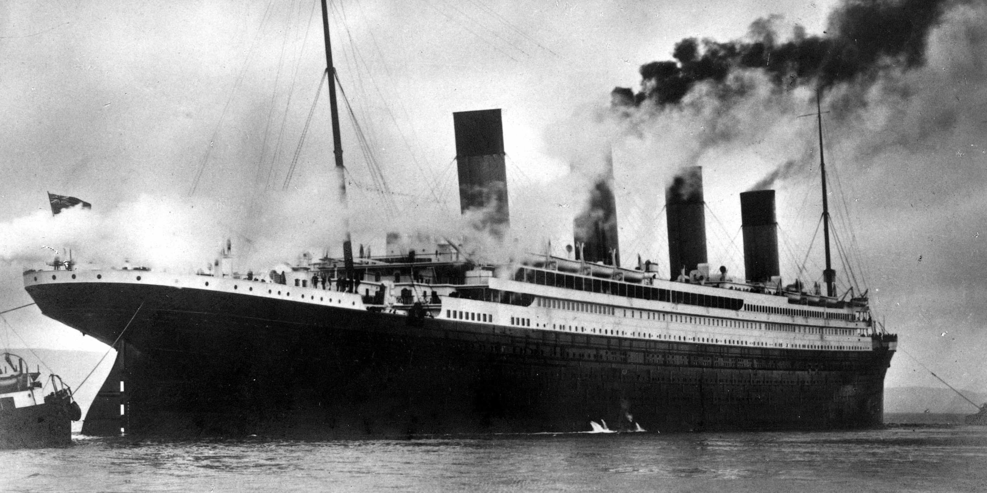

Introduction To AI
(AI101B)
Group Members :
Gauri Dhingra (202401100400090)
Ity Gaur (202401100400101)
Nirmal Singh (202401100400130)
Nischhal Garg (202401100400131)
Nitika Maan(202401100400132)

Slide 2


Titanic Survival Prediction: A Naive Bayes Approach
This presentation details our Naive Bayes model for predicting Titanic survival. We'll cover data preparation, model training, and performance evaluation.
NB
Notes:
1

Slide 3
Data Cleaning and Preprocessing
Missing Values Handled
Dataset Overview
Age: Imputed with median (29.69 years).
The dataset contains 891 passengers. Key columns include: Survived, Pclass, Sex, Age, SibSp, Parch, Fare, Embarked.
Cabin: Dropped due to high missing values.
Embarked: Imputed with mode ('S').
Notes:
2

Slide 4




Encoding Categorical Variables
Sex Encoding
Embarked Encoding
Features Dropped
'male' as 0, 'female' as 1 (Label Encoding).
'S', 'C', 'Q' using One-Hot Encoding.
Name, Ticket, PassengerId were removed for prediction.
Notes:
3

Slide 5
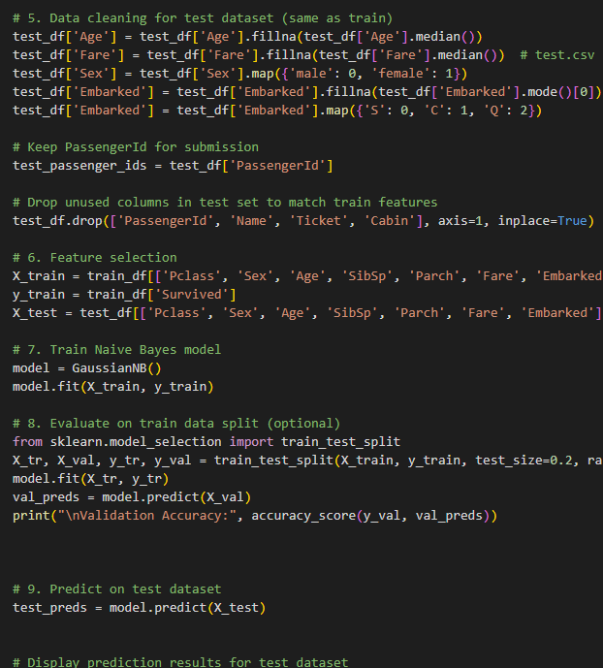



Feature Scaling (Normalization)
StandardScaler
Formula Applied
Transforms data to mean 0, variance 1.
z = (x - u) / s ensures uniform scaling.
Applied To
Age, Fare, SibSp, Parch, Pclass.
Notes:
4

Slide 6

Model Training: Naive Bayes
Gaussian Naive Bayes
Feature Independence
Our chosen algorithm for classification.
Assumes features are conditionally independent.
Data Split
70% (891 passengers) training, 30%(418 passengers) testing (random_state=42).
Notes:
5

Slide 7

Model Evaluation: Accuracy
78%
1
Baseline Accuracy
Score Calculated
Achievable with cleaned data.
Using accuracy_score function.
Accuracy measures the ratio of correct predictions. We report mean cross-validation accuracy and standard deviation for robust evaluation.
Notes:
6

Slide 8
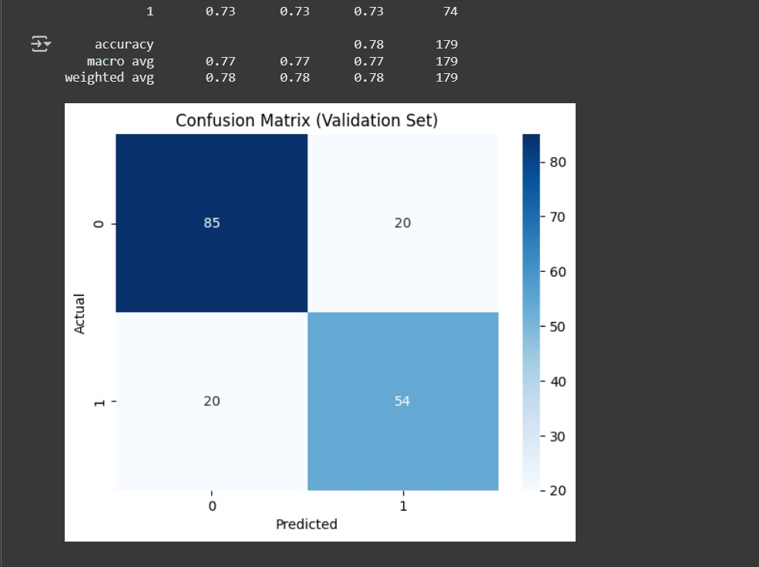
Confusion Matrix and Classification Report
True Positive (TP)
Correctly predicted survival.
True Negative (TN)
Correctly predicted non-survival.
False Positive (FP)
Predicted survival, but did not survive.
False Negative (FN)
Predicted non-survival, but survived.
The classification report provides precision, recall, and F1-score for deeper insights into model performance across classes.
Notes:
7

Slide 9








Conclusion and Key Takeaways
Naive Bayes Effective
Preprocessing Crucial
Simple yet powerful for this problem.
Significantly impacts model performance.
Model Limitations
Reasonable Accuracy
Assumes feature independence.
Model predicts survival well.
Notes:
8

Slide 10
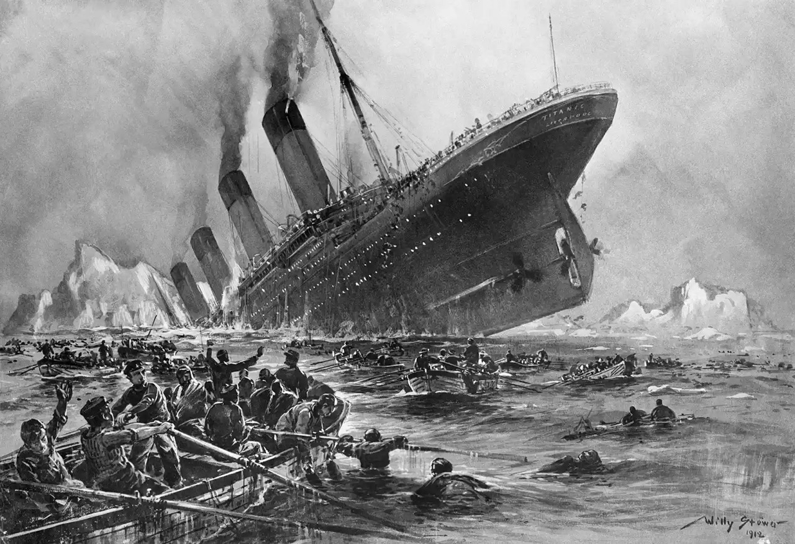

Thank You!
We hope this presentation provided a clear overview of our Titanic survival prediction model.
Notes:
10

